Slide 1
CS 113 Final Project
Created by Jack, Zach, Julian, Andrew, Nathan

Slide 2
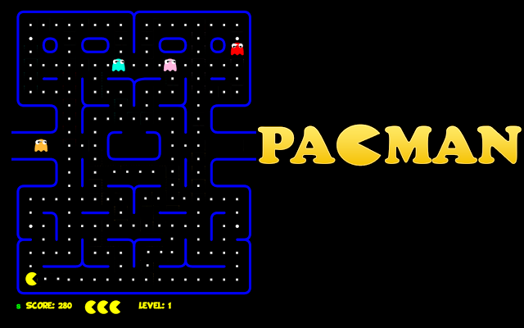
The goal

Slide 3
The goal
Create a game that embodies the essence of Pacman
Allow the player to choose a direction to move (continuously)
Have unique entities like coins, cherries, walls, and ghosts.
Handle hit detection and results between entities.
Coins: Can be picked up when the player touches them.
Cherries: Similar to coins, but with a twist…
Walls: Prevents the player and ghosts from moving through an area.
Ghosts: Ends the player upon contact.
Allow enemies to move (toward the player, randomly, in patterns…)

Slide 4
The approach
Create several classes which define, control, or display the game.
Position2D: Defines 2D spaces for hit detection size and coordinates
Entity: Base class of all entities such as Pacman, Walls, Ghosts, etc…
SystemManager: Hosts logic, movement input, and entity creation.
GraphicsController: Extends JFrame to display the game.
CenterPanel: Extends JPanel to draw entities.
MainDriver: Contains main method used at runtime.

Slide 5
The approach
The Position2D Class:
Defines where an entity is.
Defines how much space an entity occupies.
Fairly straightforward class.
Uses integers (int) to record a position in the game with X, Y coordinates.
Uses integers (int) to record a size in the game with width and height.
Contains methods to compare Positions for overlap (collisions).

Slide 6
The approach
The Entity Class:
Inspired by Minecraft’s Entity Class.
Has a Position2D object.
Has a Color object.
Minor control over movement.
paintEntity method: Uses a Graphics object to draw this entity.
Parent class of all entities in the game.
Pacman: Represents the player. Can be steered using the arrow keys.
Ghosts: Chase the player.
Coins: pickup.
Walls: Keeps the player, and ghosts in bounds.

Slide 7
The approach
The SystemManager Class:

Slide 8
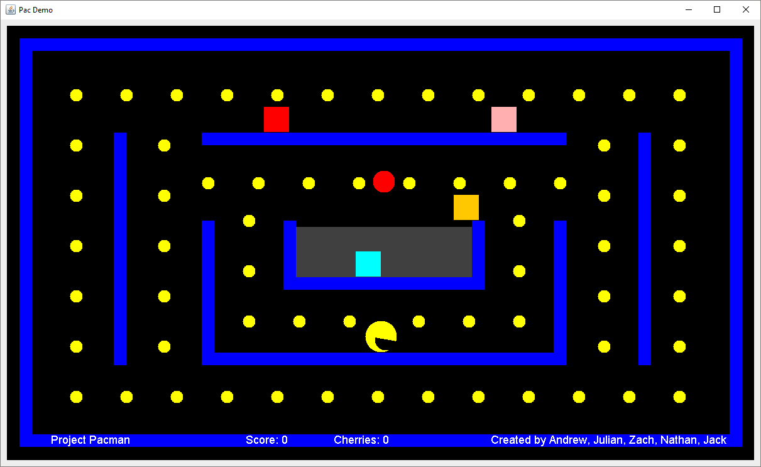
The result

Slide 9
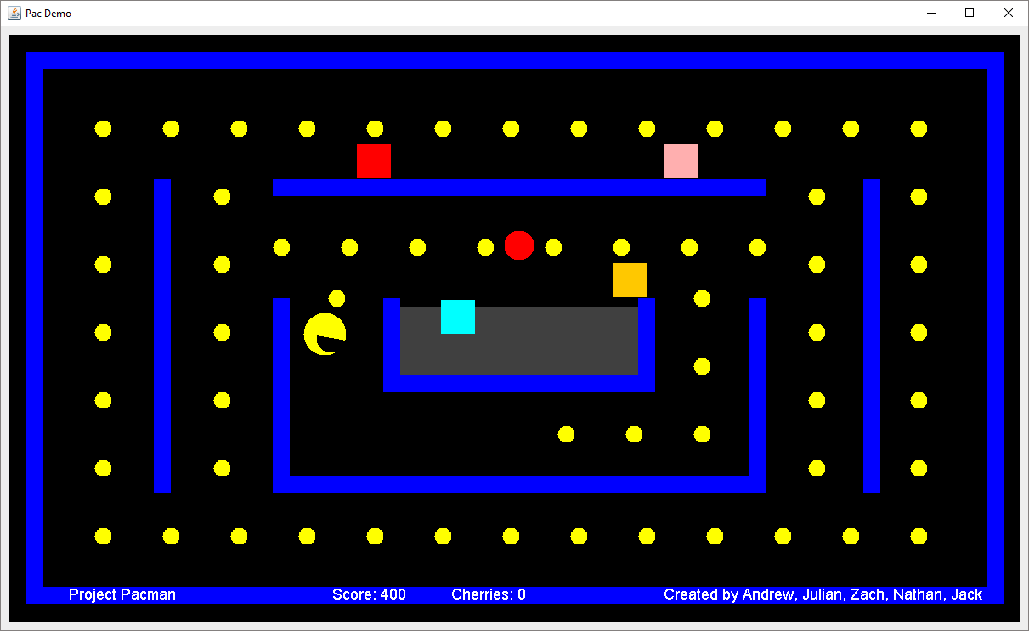
The result

Slide 10
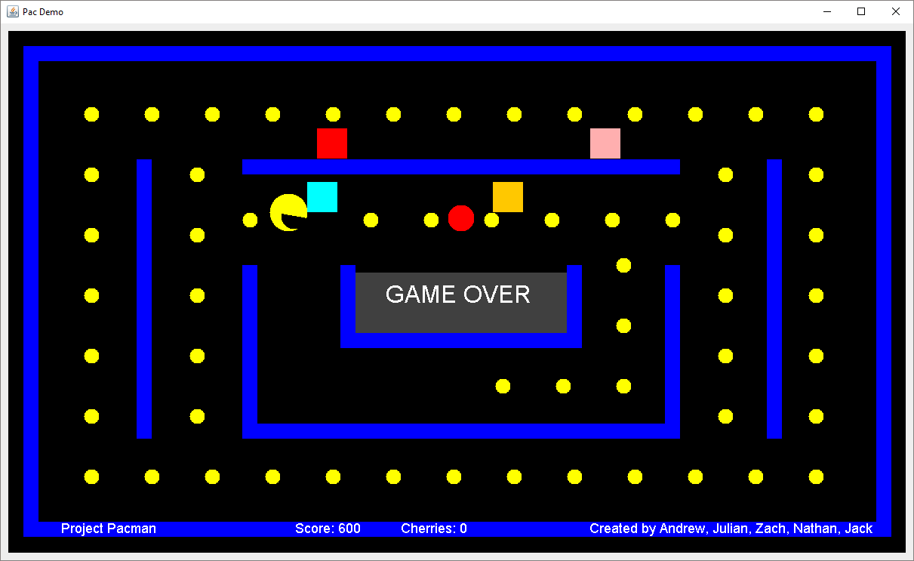
The result

